Slide 1




ARMIGO
Gamified VR-Based Therapy System for Upper Limb Rehabilitation for Children with Hemiplegia.
Transforming clinical therapy into an immersive adventure for Children using Deep Learning and advance motion tracking
Progress presentation 2
06 Jan, 2026
10/03/2026
25-26j-472
1

Slide 2
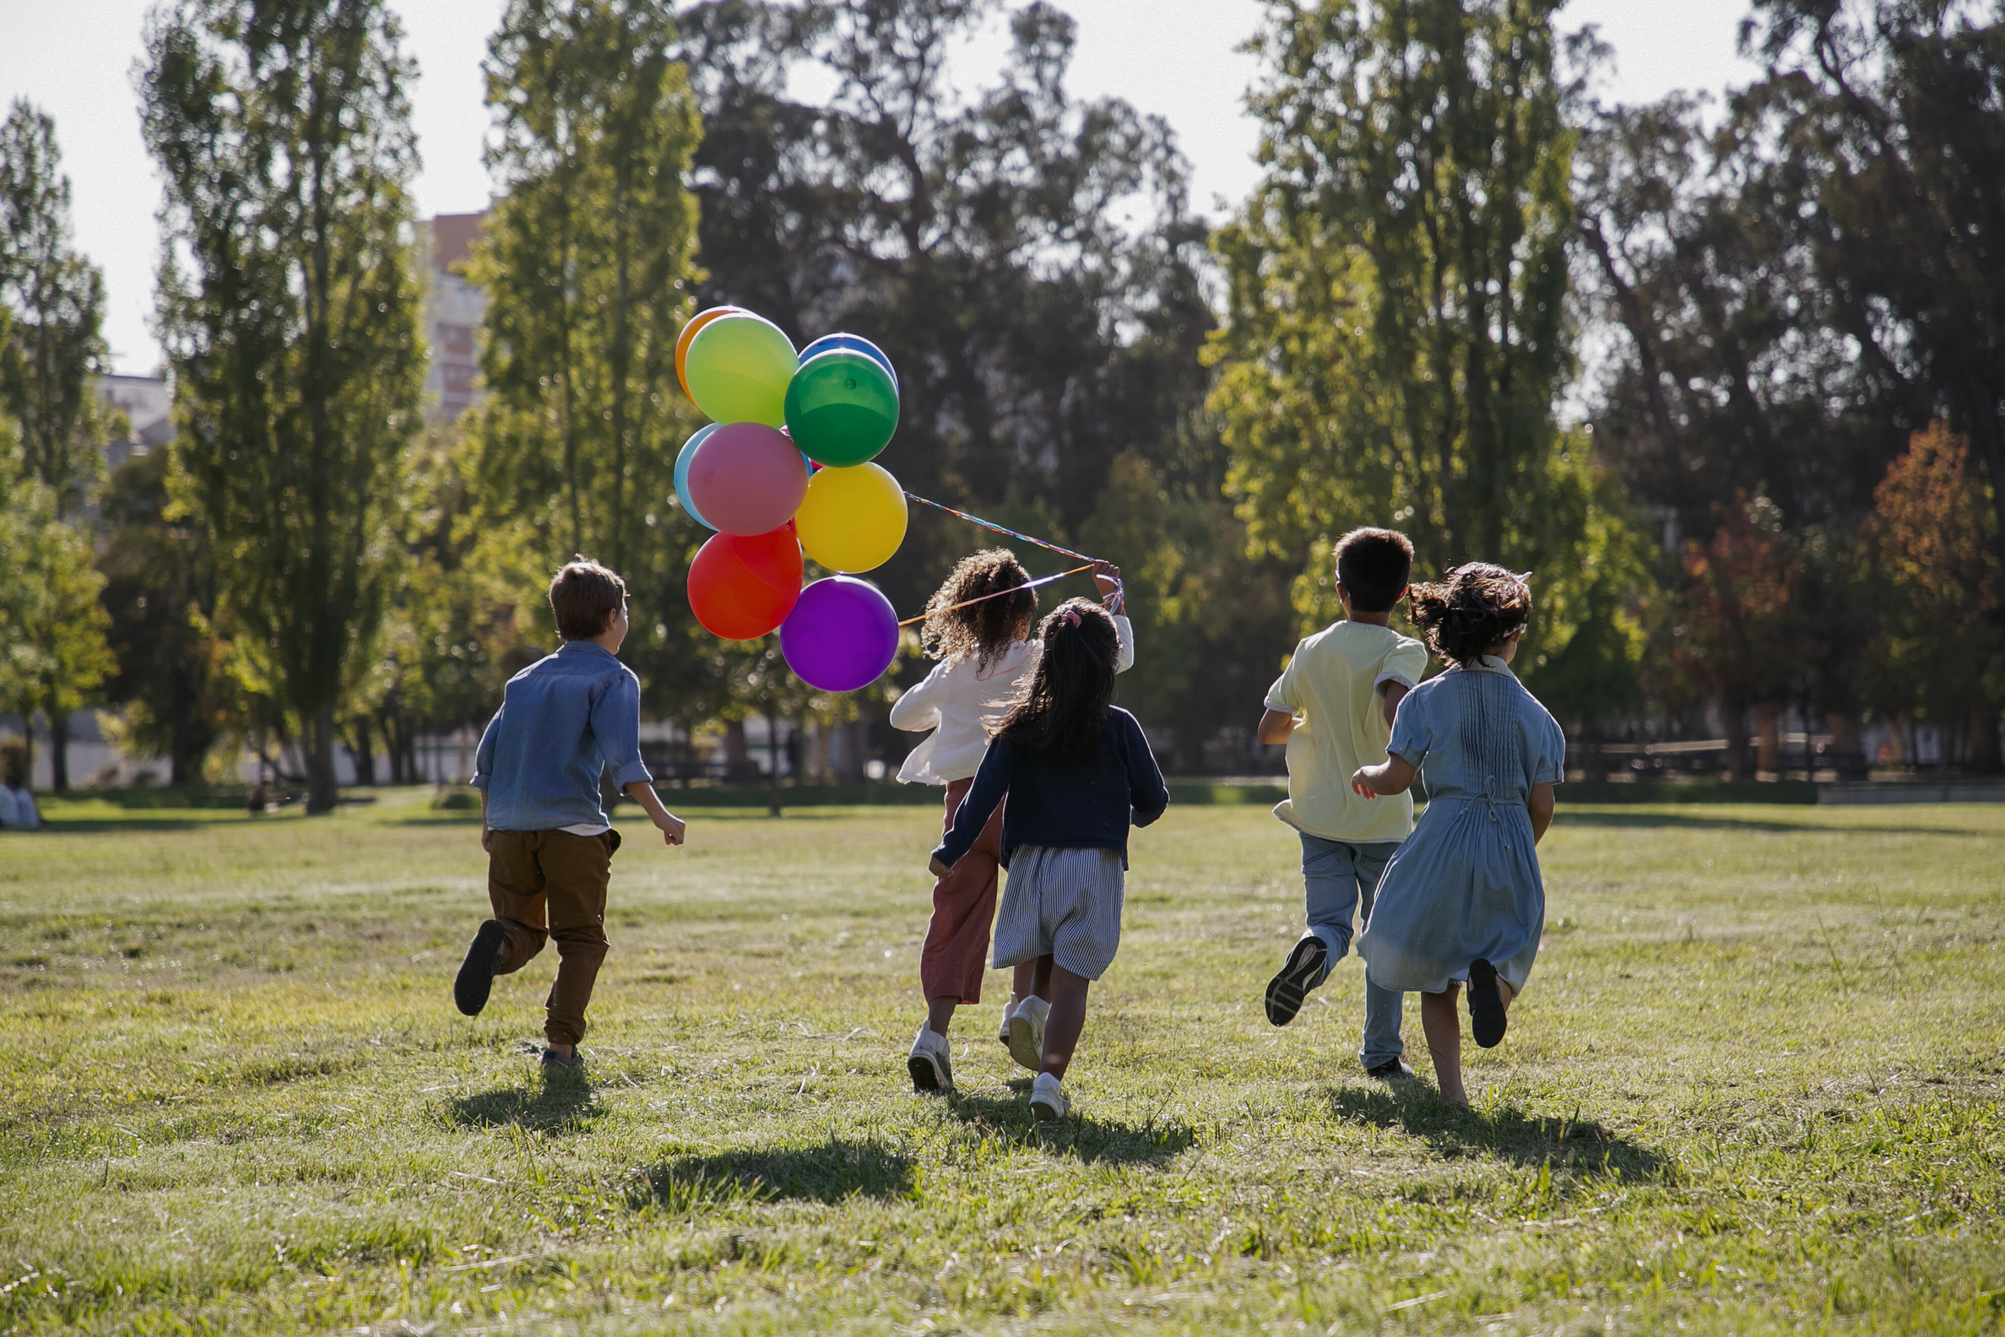
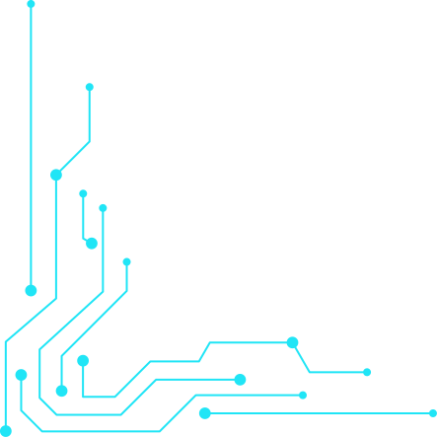
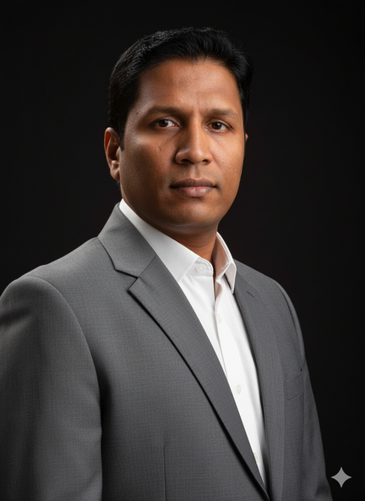

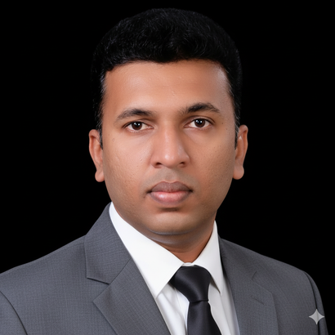



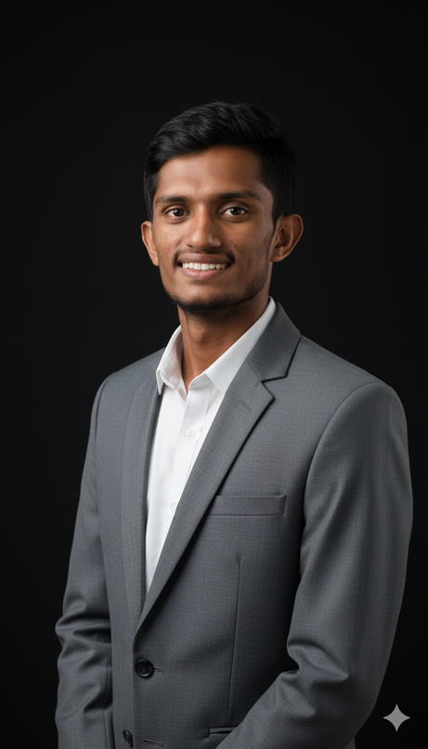
Our Team
Supervisor
Co - Supervisor
External Supervisor
Mr. Didula Chamara Thanaweera Arachchi
Mr. Eishan Dinuka Weerasinghe
Mr. Buuddhika Senevirathene
Project Manager
Project Member
Project Member
Project Member
Asanka Wickramasurendra
Sanjana Nimesh
Dinithi Weerasinghe
Anushka Siyambalapitiya
25-26j-472
2

Slide 3
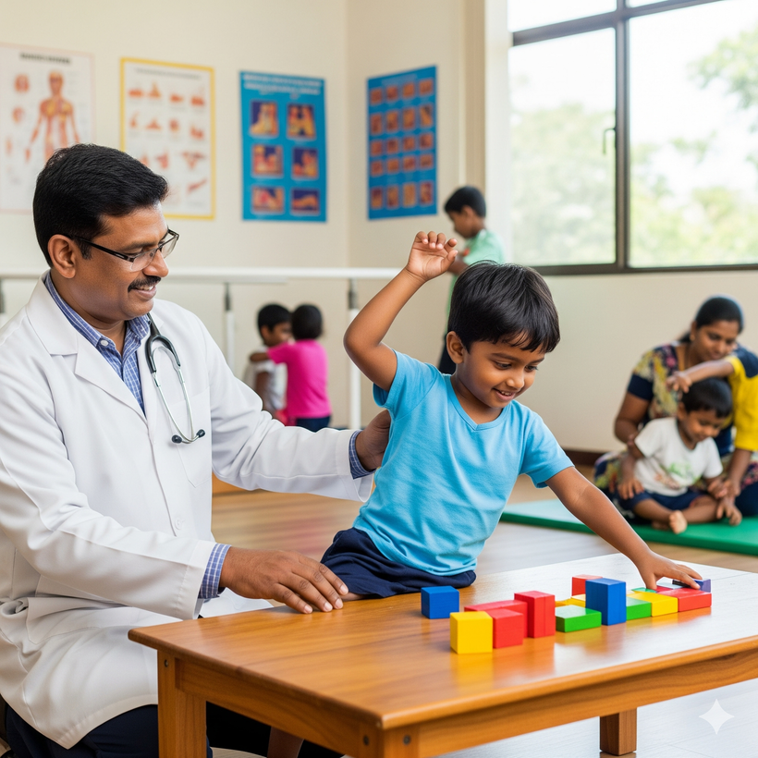
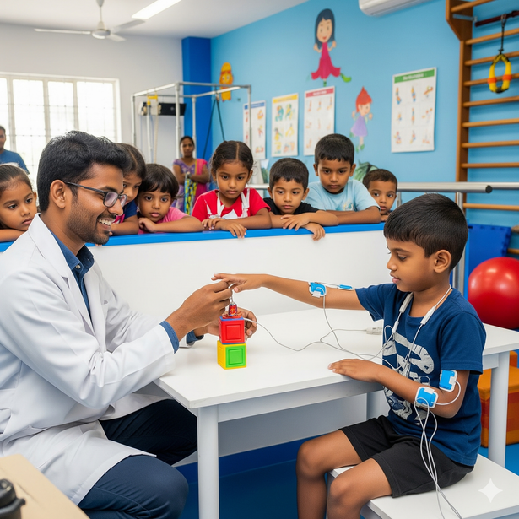

Agenda
01
Introduction
02
Research Problem and Impact
03
Objectives and Benifits
04
Design Excellence of the proposed Solution
05
Overall System Diagram
06
Data Collection
07
Commercialization
08
Risk Mitigration
09
Demonstration Plan and Roles
25-26j-472
3

Slide 4
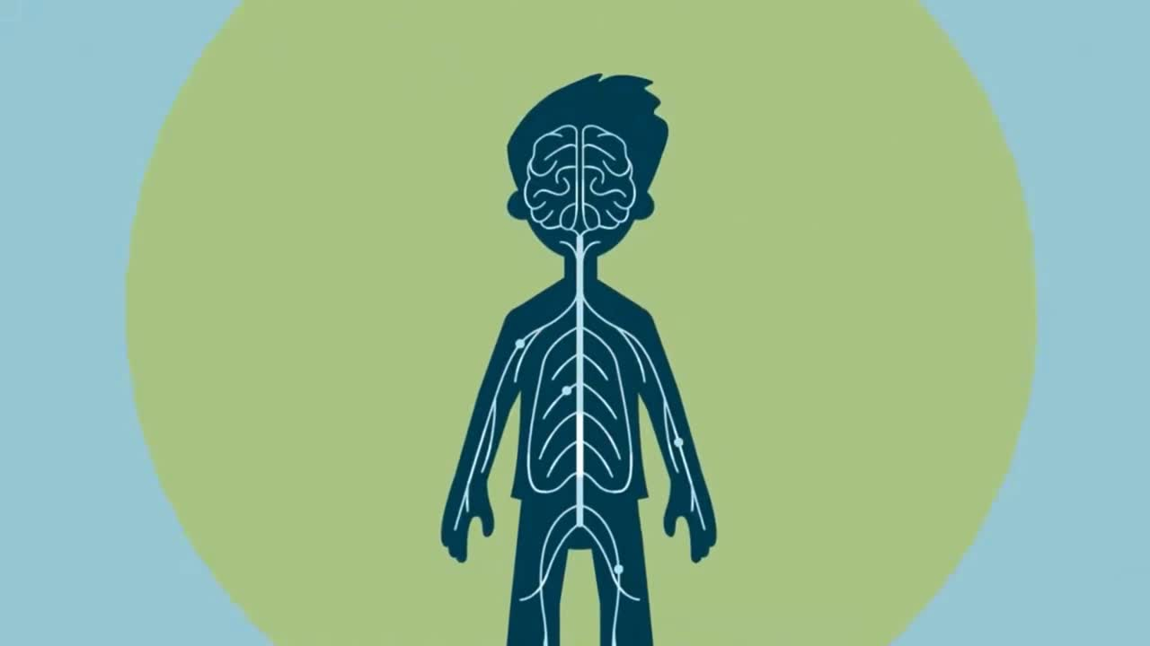
4

Slide 5
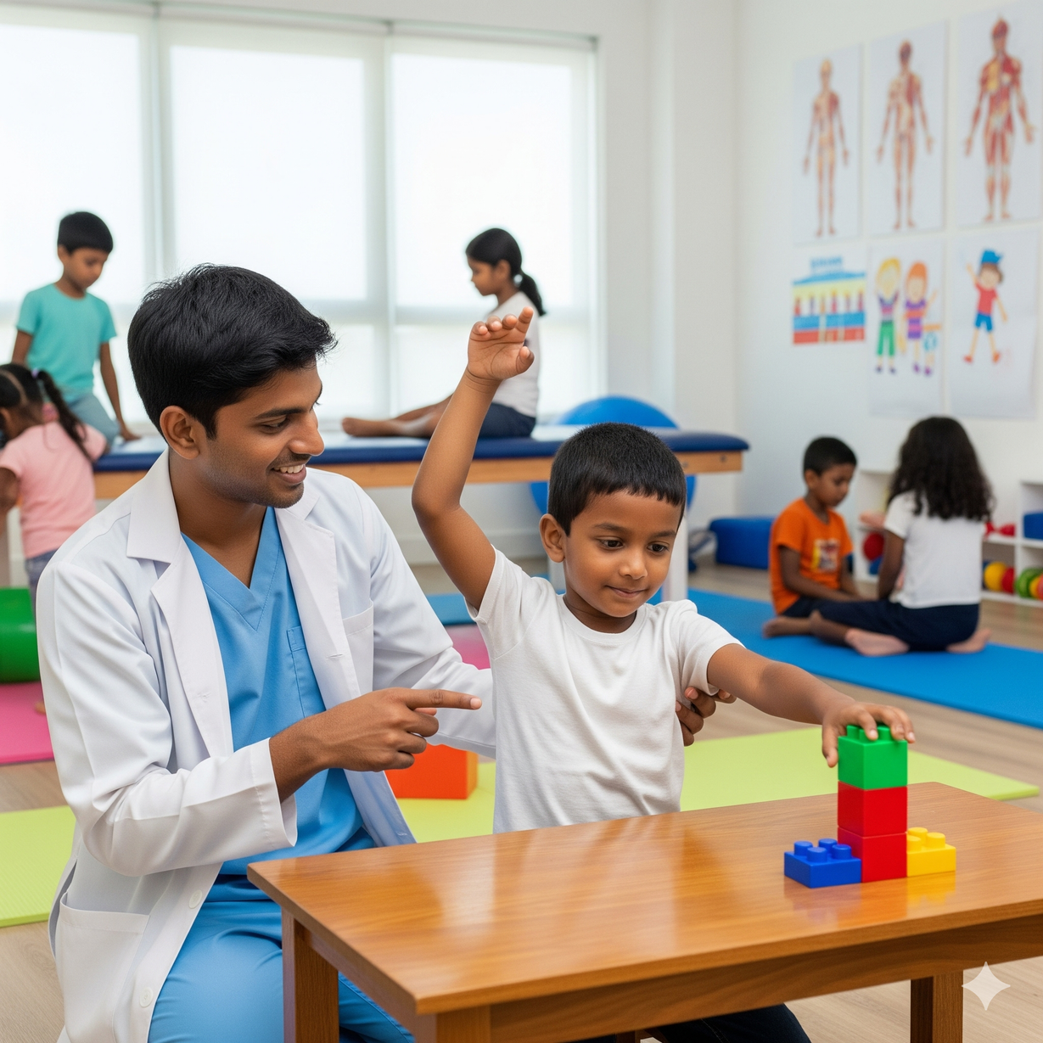
Introduction
ARMIGO
ARMIGO is a wearable, AI-powered rehabilitation system designed for upper limb therapy in children with hemiplegia.
  Multi-sensor wearable modules placed on fingers, wrist, elbow, and shoulder
  Collects real-time motion data using IMU and flex sensors
  Uses Machine Learning models (LSTM) for:
Movement recognition
Quality classification of exercises
  Therapy delivered through interactive VR-based games
  Provides real-time feedback
  Includes a therapist dashboard for doctor/parent monitoring
  Tracks patient progress based on performance data
25-26j-472
5

Slide 6
Research Problem and Impact
🚩 Problem | ⚠ Impact
Adult-focused rehabilitation systems | ❌ Low suitability for children
Expensive & complex hardware | ❌ Limited home accessibility
Poor monitoring & feedback integration | ❌ Weak personalization
Limited finger & elbow tracking | ❌ Inaccurate movement assessment
Low caregiver involvement | ❌ Inconsistent therapy practice
No adaptive motivation (voice, rewards, storytelling) | ❌ Reduced child engagement
6
25-26j-472

Slide 7
Research Gap
• Limited pediatric-focused rehabilitation systems
Most existing VR rehabilitation solutions are designed for adult patients, with very few systems targeting children with hemiplegia.
• Incomplete upper-limb motion tracking
Current wearable rehabilitation devices often track only simple finger or hand movements, ignoring multi-joint coordination (wrist, elbow, and shoulder) and compensatory motion patterns.
• Lack of intelligent rehabilitation monitoring
Many systems do not provide real-time monitoring, progress tracking, or remote supervision for clinicians and caregivers.
• Low engagement in traditional therapy
Conventional rehabilitation exercises are repetitive and non-interactive, resulting in low motivation and poor adherence among pediatric patients.
• Limited access to physiotherapy services in Sri Lanka
There is a shortage of pediatric physiotherapists, unequal distribution of rehabilitation centers, and high treatment costs, especially in rural areas.
• Insufficient research combining VR, ML, and wearable sensors
Few studies integrate low-cost wearable sensing, machine learning, and gamified VR environments specifically for pediatric hemiplegia rehabilitation.
7
25-26j-472

Slide 8
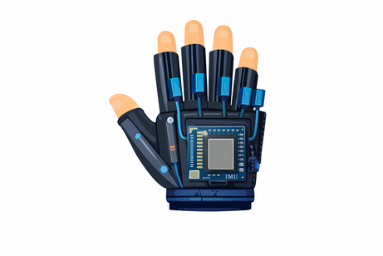
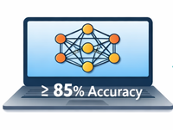



Rsearch Objectives
Develop a Gamified Rehabilitation system for Upper Limb therapy in Children with Hemiplegia
Wearable IOT Device
IMU & Flex sensors(ESP32)
Motion Recognition
LSTM Model
Gamified Therapy Environment
Adaptive and Interactive Games
Remote monitoring
physiopists and parents dashboards
Pilot Testing and Evaluation
Usability & Engagement Analysis
25-26j-472
8

Slide 9
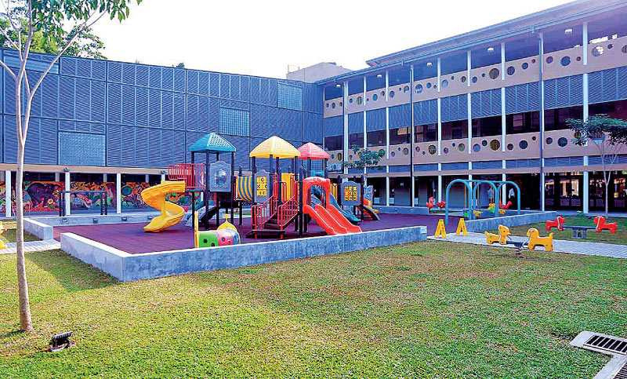
Who Will Be Benefited by the Solution
Primary Beneficiaries
  Children with Hemiplegia in Sri Lanka and similar low-resource settings, who currently lack access to engaging, affordable, and effective upper-limb rehabilitation.
  Parents and Caregivers, who can support their child’s therapy at home with guided, interactive tools.
Secondary Beneficiaries
  Pediatric Physiotherapists and Rehabilitation Clinics (e.g., Sirimavo Bandaranaike Children’s Hospital, Ayati Centre), who can remotely monitor multiple patients, reduce workload, and provide data-driven therapy adjustments.
  Healthcare Institutions and NGOs, especially in rural or underserved areas, where specialist access is limited.
Social Impact
  Increased Access to Quality Rehabilitation.
  Improved Rehabilitation Outcomes
  Empowerment of Families and Therapists
  Cultural Relevance and Scalability
  Can facilitate the service to the rural areas.
25-26j-472
9

Slide 10
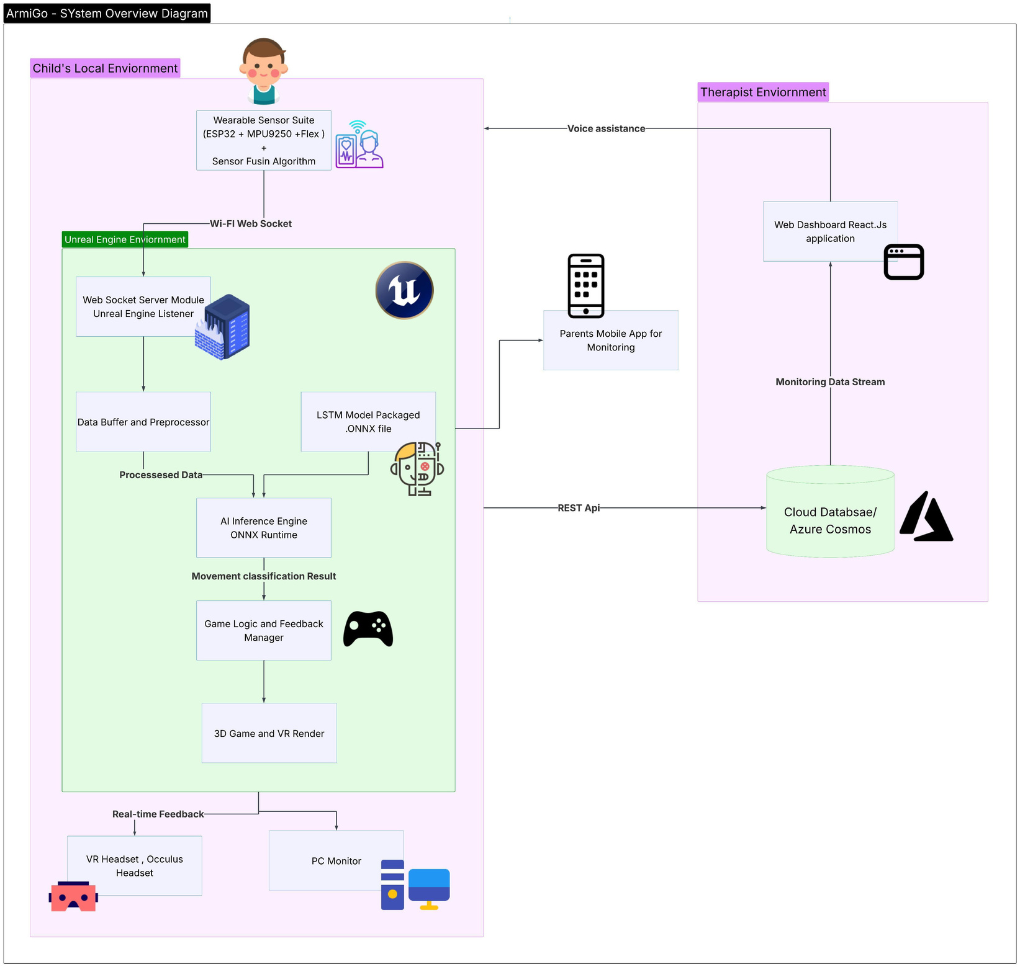
Overall System Diagram
  First Integrated Pediatric System – Tracks finger, wrist, elbow & shoulder together in one affordable VR platform.
  Real-Time AI Feedback – Uses LSTM models to analyze movement quality and correct compensations instantly.
  Child-Centered Gamification – Engaging Unreal Engine games keep kids motivated and therapy consistent.
  Accessible & Low-Cost – Built with ESP32 & MPU9250 sensors, designed for home use in low-resource settings.
  Remote Care Ecosystem – Clinician dashboard + parent app enable monitoring & personalization from anywhere
10
25-26j-472

Slide 11
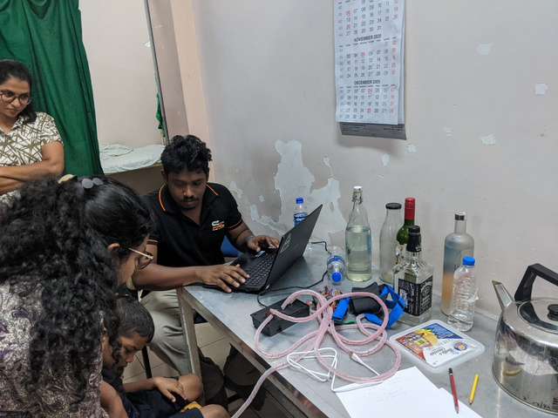
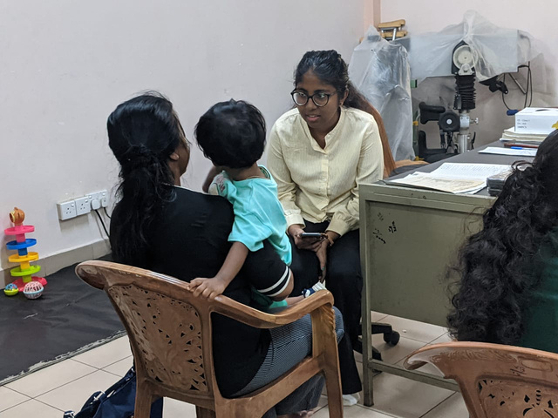
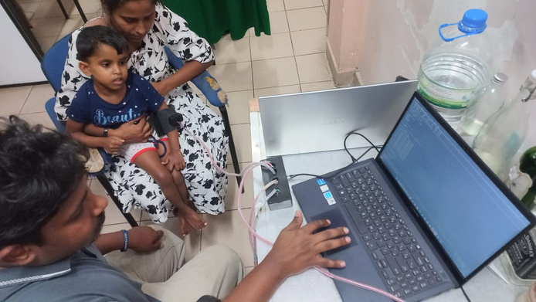
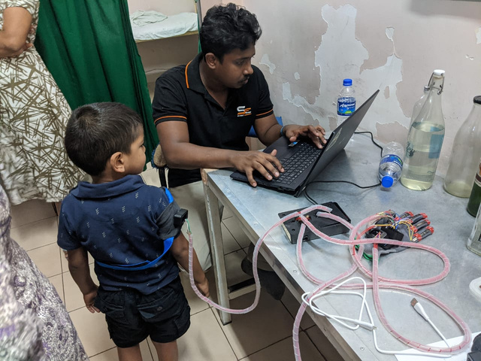
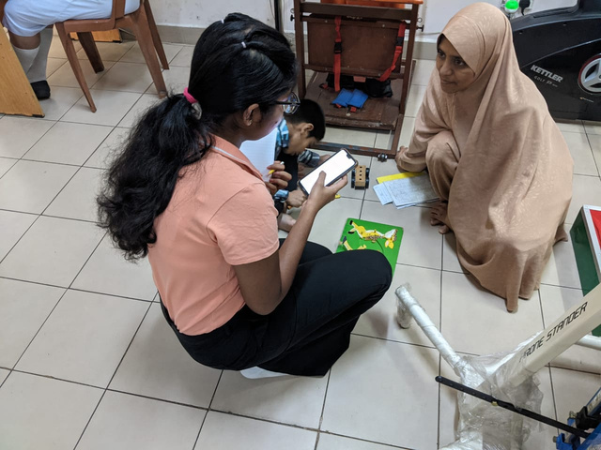
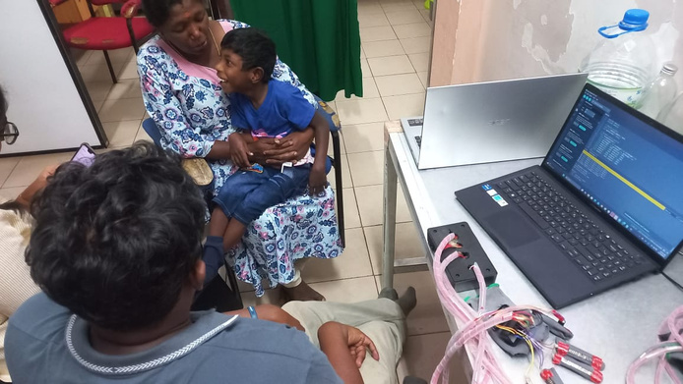
Data Collection - Sirimawo Bandaranayaka Specialized Children’s Hospital Peradeniya
We got a sequence of diformative movements, which is very important to train the model and compare with the healthy movement range.
11
25-26j-472

Slide 12
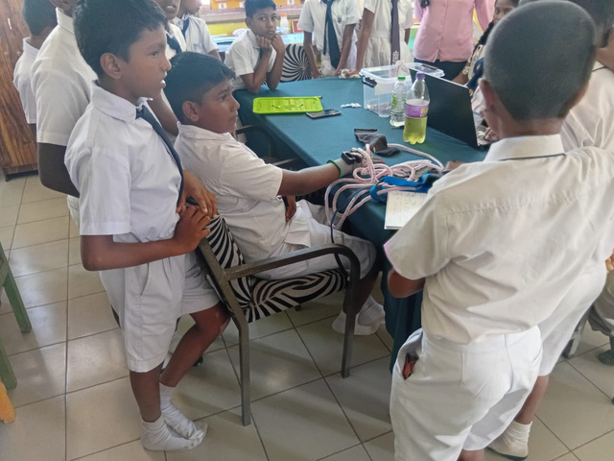
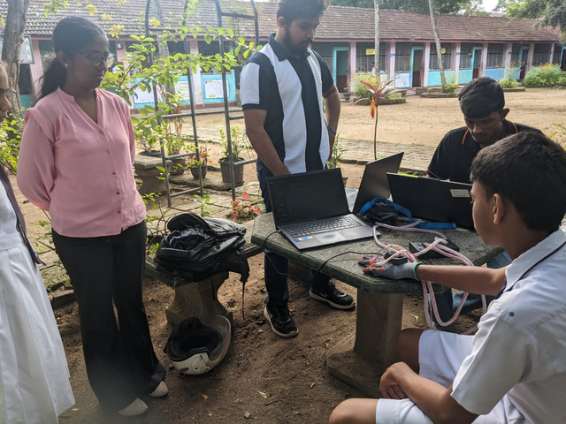
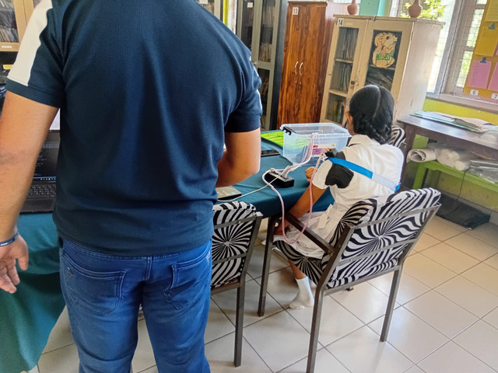
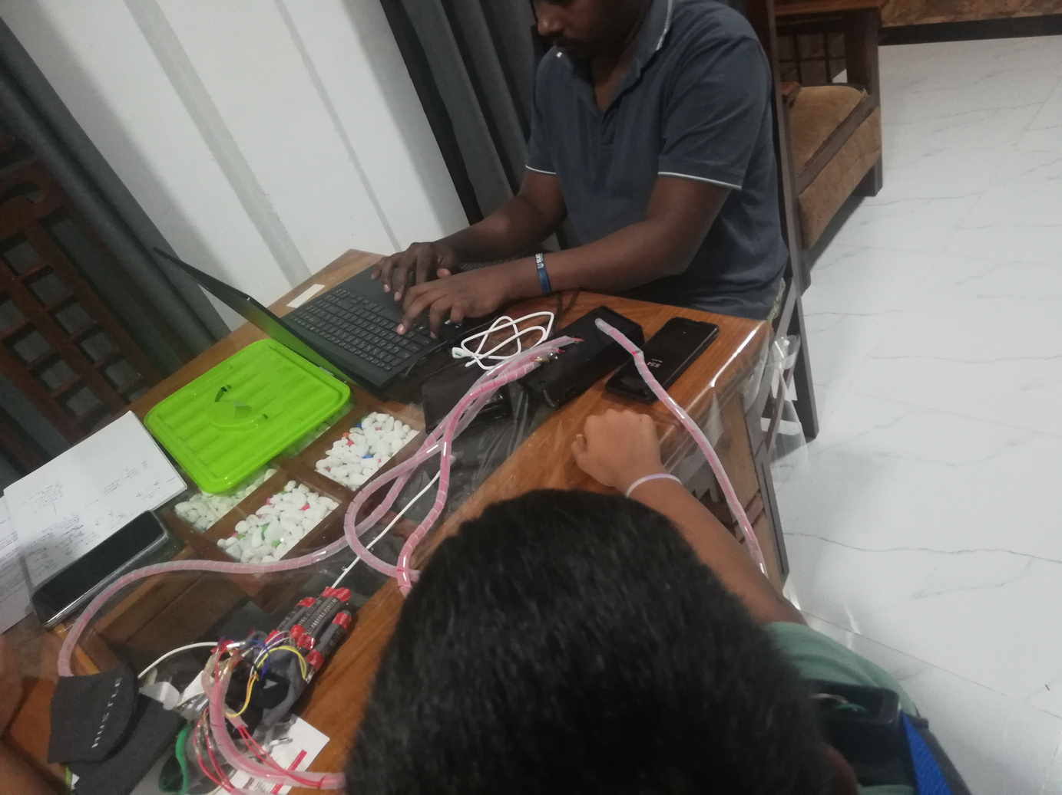
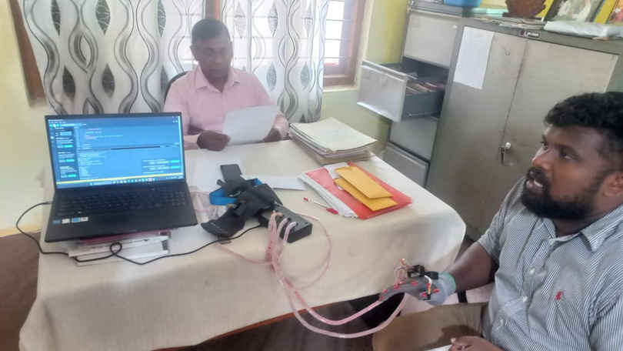
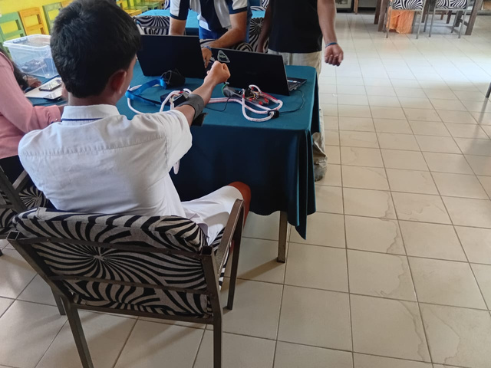
Data Collection - Kurunegala and Kandy District schools
To get the healthy childrens’ movement range, we visited multiple schools with the permission of their representative zonal educational departments.
12
25-26j-472

Slide 13
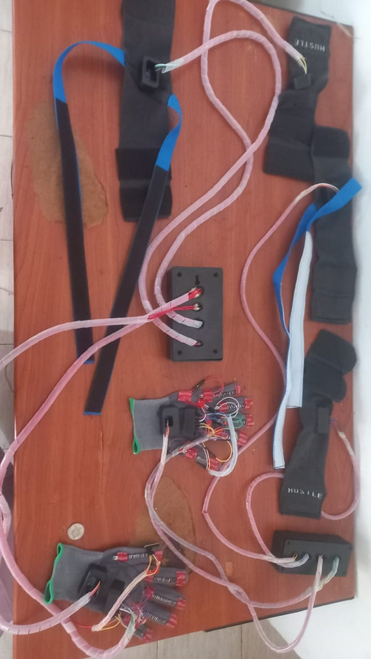
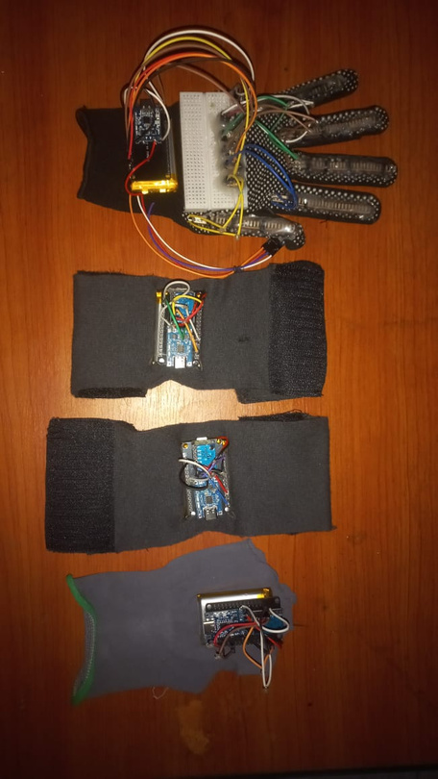
ARMIGO IOT Device.
Primary Wearable IOT Device
Updated Wearable IOT Device
This device was the prototype design attempt for our project; we used a USB cable to transmit data and power. To integrate as one device, we use wires.We used this device in our data collection phase
This device is the most updated version of our project; we used a wifi to transmit data, and a rechargeable battery to get the power.
13
25-26j-472

Slide 14
Integration points
Hardware-Software Integration
  Sensor data from all modules (shoulder, elbow, wrist, finger) aggregated via ESP32 microcontrollers
  Wireless transmission to the local backend server for real-time synchronization and processing
User Interaction & Game Integration
  Unreal Engine UI allows selection of specific body parts (Wrist, Elbow, Shoulder, Fingers)
  Selection interface dynamically enables/disables corresponding sensor streams and game mechanics
  Processed sensor data mapped to in-game avatar in real-time
  Avatar mirrors child's actual movements for selected body parts
  Immediate visual/auditory feedback based on movement correctness
14
25-26j-472

Slide 15
Integration points
Web, Mobile & Desktop Application Integration
  Web App: Therapists monitor progress, review sessions, and adjust treatment plans remotely via browser dashboards
  Mobile App: Parents receive push notifications on session completion, progress updates, and therapy reminders
  Desktop App: Clinicians perform deep data analytics, generate reports, and configure therapy parameters during clinic visits
  All three platforms synchronized with same cloud database ensuring real-time data consistency
  Role-based access control implemented for therapists, parents, and clinicians
15
25-26j-472

Slide 16
Deployment/runtime setup
  Hostinger VPS: Ubuntu 22.04 with Nginx, PM2, SSL, and firewall configured for security
  Backend: Nest.js APIs hosted at https://api.armigorehab..com with PM2 and PostgreSQL database
  Web App: Therapist dashboard (Next.js) at https://web.armigorehab.com with SSL for remote access
  Mobile App: Connects to backend APIs with push notifications for parents on session updates
  Desktop App: Clinician analytics tool with role-based access via secure API connection
  Data Sync: All platforms synchronized with same cloud database for real-time consistency
  Runtime: Local therapy works offline; data syncs to VPS when online
16
25-26j-472

Slide 17

Primary Stakeholder
Dr. Buddhika Senevirathne (PhD)
Head – Department of Physiotherapy
Children’s Hospital
Peradeniya, Sri Lanka
17
25-26j-472

Slide 18

Gamified VR-Based Therapy System for Upper Limb Rehabilitation for Children with Hemiplegia.
Commercialization
Target Market & Customers
  Primary: Hospitals & rehab clinics (e.g., Ayaathi centre, Sirimawo Bandaranayaka Children’s Hospital)
  Secondary: Families for home-based therapy
Value Proposition
  Therapists: Affordable remote monitoring with data
  Families: Engaging gamified home therapy
  Differentiator: 1st low-cost holistic pediatric solution
Investment & Cost Recovery
  Unit Cost: ~LKR 125 020
  B2B Price: LKR 150,000 (kit) + SaaS subscription
  B2C Price: LKR 125,000 (one-time)
  Cost Recovery: Revenue funds scaling & support
IP Strategy
  Core IP: Sensor fusion & ML movement algorithm
  Protection: Sri Lankan Patent + Copyright + "ArmiGo" TM
18

Slide 19
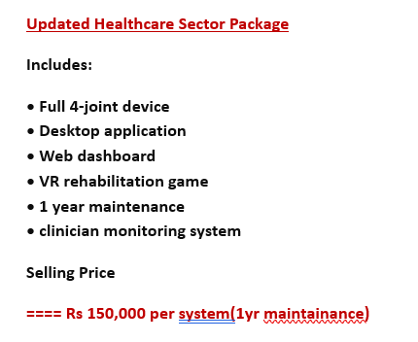
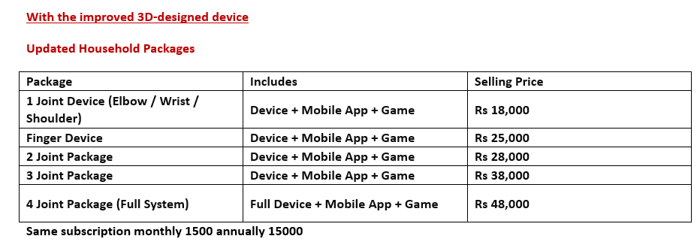
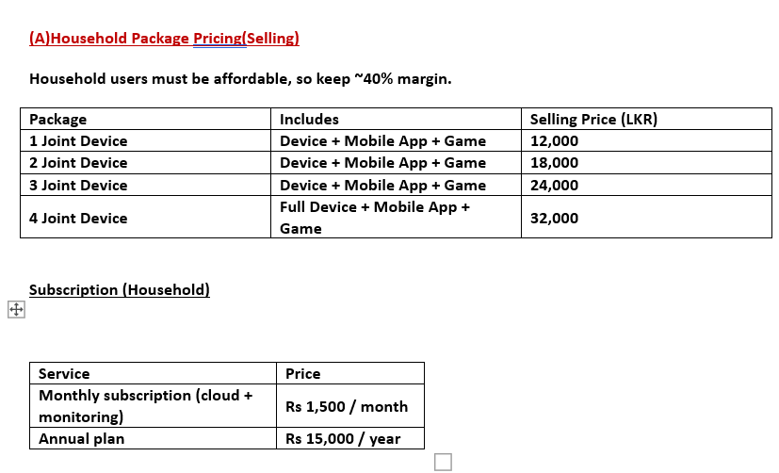
Commercialization
After 1st year, we are willing to charge LKR 12,000 maintainance charge.
19

Slide 20

Gamified VR-Based Therapy System for Upper Limb Rehabilitation for Children with Hemiplegia.
Risk Mitigation
  Technical risks are managed through sensor calibration, optimized processing, durable hardware, and child-friendly VR design.
  Data and ML risks are addressed via multi-clinic collaboration, encryption, anonymization, and continuous model validation.
  Usability and adoption risks are mitigated by updating game content, simplifying setup guides, and involving therapists early.
  Clinical and ethical risks are controlled through hospital-based pilot testing, ethical clearance, and therapist oversight.
  Business and scaling risks are reduced by sourcing local components, supporting multiple platforms, and securing IP protection.
  Overall strategy ensures safety, accessibility, and sustainability of the ArmiGo system for pediatric rehabilitation
20

Slide 21
Dwmonstration Flow
(01) Overall System Demonstration.
Landing Page
Web Application(IT22102546)
Desktop Application(IT22115720)
Mobile Application(IT222557292)
(02) Sensor Involvement.(IT22119230)
(03) Wifi Integration(IT22115720)
(04) Individual Component
(05) Deployment (IT22102546)
21

Slide 22
IT22102546
Nimesh S D S
Specialization : Software Engineering
FINGER MOVEMENT TRACKING AND FINGERS BASED THERAPY FOR CHILDREN WITH HEMIPLEGIA
IT22102546
Nimesh S.D.S
25-26j-472
06/01/2026
22

Slide 23
IT22115720
Wickramasurendra K.D.A.D
Specialization : Software Engineering
SHOULDER MOVEMENT TRACKING AND SHOULDER-BASE THERAPY GAME FOR CHILDREN WITH HEMIPLEGIA
IT22115720
Wickramasurendra K.D.A.D
25-26j-472
06/01/2026
23

Slide 24
IT22119230
Weerasinghe D.N.T
Specialization : Software Engineering
ELBOW MOVEMENT TRACKING AND ELBOW-BASED THERAPY FOR CHILDREN WITH HEMIPLEGIA
IT22119230
Weerasinghe D.N.T
25-26j-472
06/01/2026
24

Slide 25
IT22557292
Siyambalapitiya S V A P B
Specialization : Software Engineering
WRIST MOVEMENT TRACKING AND THERAPY FOR CHILDREN WITH HEMIPLEGIA
IT22557292 Siyambalapitiya S.V.A.P.B 25-26J-472
06/01/2026
25

